Slide 1
SP3D Equipment and Piping Reference Data
Ramon Him
July, 2006

Slide 2
What will be covered in this training?
Overview:
SmartPlant 3D Reference Data
- Delivered Backup Catalog vs New Catalog
- Delivered Reference Data
- Bulkload Utility
- Catalog Hierarchy
- Module Types
- Code List
Equipment Reference Data
- Equipment Hierarchy
- Custom Interfaces – Attribute Management
- Equipment Assembly Class
Piping Reference Data
- Delivered Piping Reference Data
- Piping Material Class Data
- Piping Material Class Rules
- Piping Commodity Filter
- Piping Specification Validation
Piping Commodity Material Control Data
Synchronization between Model & Catalog
Piping Commodity Part Data
Additional Piping Specification Rules
Connection Selection Filters
Piping Commodity Generic Data
Valve Operators
Instrument & Specialty Items
Bolt Length Calculations
Interactive Spec Writing (Optional)

Slide 3
SP3D Databases - Overview
Site Database:
Contains Project Management data such as the names of the databases, global work share locations and the permissions on the model and catalog databases.
Catalog Database:
Contains the design rules and the parts.
Model Database: Contains instances of the parts defined in the catalog.
Report Database : Collection of views on the model, site and catalog.
Schemas: Contains the data about the data. Describes all the business objects for the applications (pipe, fitting, beam, etc…) and their relationships.
Report Database set
Site Database set
Model Database
Catalog Database set
Notes:
Page 19

Slide 4
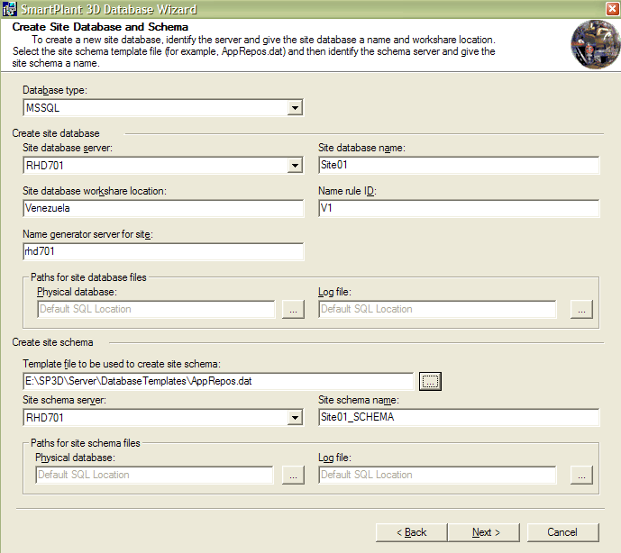
SP3D Databases - Overview
Step 1
A site database and schema are created from a “.dat” file in MS SQL Server 2000 or from a “.dmp” file in Oracle. These files are delivered with the product.
  The “.dat” or “.dmp” files contain the MetaData (or data about the data), which describes all the business objects for the core, and project management applications and their relationships.
Site Database Schema
Metadata from AppRepos.dat or AppRepos.dmp

Slide 5
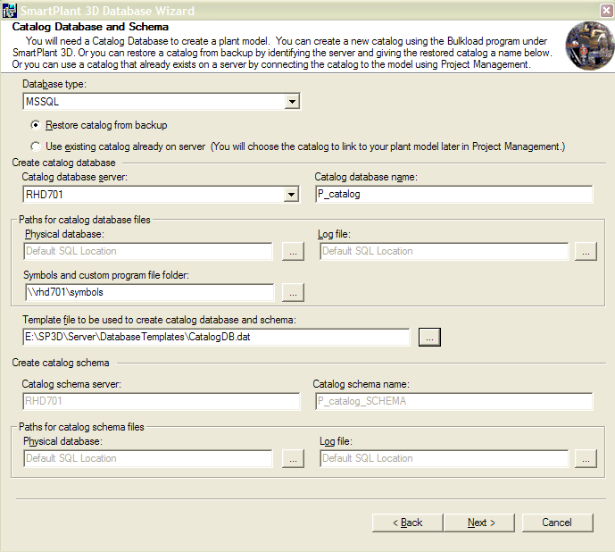
SP3D Databases - Overview
Step 2
A catalog database and schema are created from a “.dat” file in MS SQL Server 200 or from a “.dmp” in Oracle. These files are delivered with the product.
  The “.dat” or “.dmp” files contain the design rules, parts and the MetaData of the other applications (Equipment, Route, Structure, etc..)
Catalog Database Schema
Metadata from Catalogdb.dat or Catalogdb.dmp

Slide 6
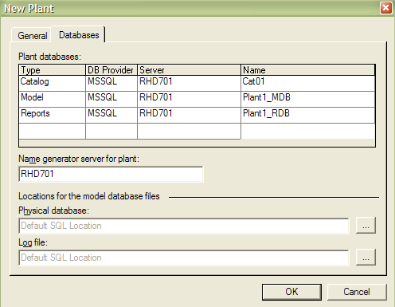
SP3D Databases - Overview
Step 3
A Model is created using the Project Management environment. This action creates a new model database in MS SQL Server 2000/Oracle and associates the Model to the desired catalog.
The Report database and schema are created in this step.
Site Database set
Report Database set
Model Database
Catalog Database set

Slide 7
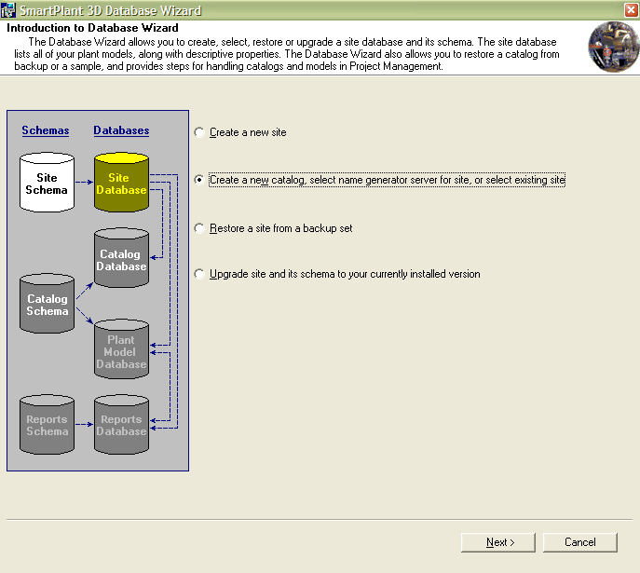

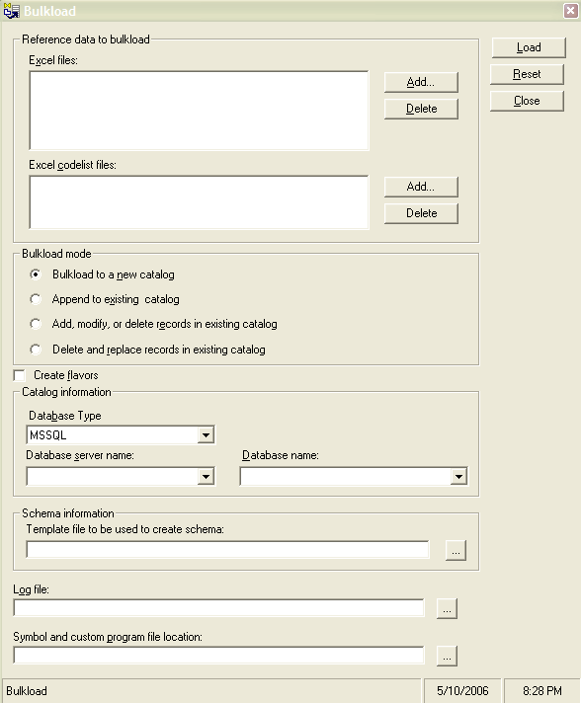

Catalog Database
Database Wizard:
Quick restorable Catalog Database set that contains all Intergraph delivered sample data or restore your own CatalogUser.dat/CatalogUser.dmp
Bulkload Utility:
Creates new Catalog Database(s), and is used to maintain
existing Catalog Database(s).

Slide 8
Catalogdb.Dat (SQL Backup Database)
Reference Data
  Parts (Equipment, Piping, HVAC, Cable tray, Structure, etc..)
  Rules (piping specifications, slabs specifications, etc…)
  Generic data tables
  Labels and report definition
  IFC Rules
  Naming rule definition
  and so on……

Slide 9
Using Excel Workbooks to Configure Reference Data:
  All non-graphical SmartPlant 3D reference data is stored in Microsoft Excel
  Workbooks. The default location for reference data workbooks is [Product
  Directory]\Catalog Data\BulkLoad\DataFiles.
  For example,
AllCodelist.xls
AllCommon.xls
ModuleTypes.xls
GenericNamingRules.xls
Reports.xls
IFCRule.xls
InsulationData.xls
Drawings.xls
BulkLoadIsoKeys.xls
Equipment.xls
EquipmentComponent.xls
Standard Nozzle Data.xls
Shapes.xls
Notes:
Delivered Excel workbooks page 56

Slide 10
Using Excel Workbooks to Configure Reference Data: (Cont.)
  Additional Reference Data is located in [Product Directory] \CatalogData\BulkLoad\AdditionalDataFiles\ and
  [Product Directory] \CatalogData\BulkLoad\SampleDataFiles
Equipment_SE.xls
Electrical Equipment.xls

Slide 11
Catalog Database Creation
Bulk Load Utility
AppRepos.Dat
New Catalog &
Catalog Schema
Reference Data
Excel workbooks
To add reference data to the catalog, you use the Bulkload utility to transfer Excel workbook data into the Catalog Database.
Notes:
10
6

Slide 12
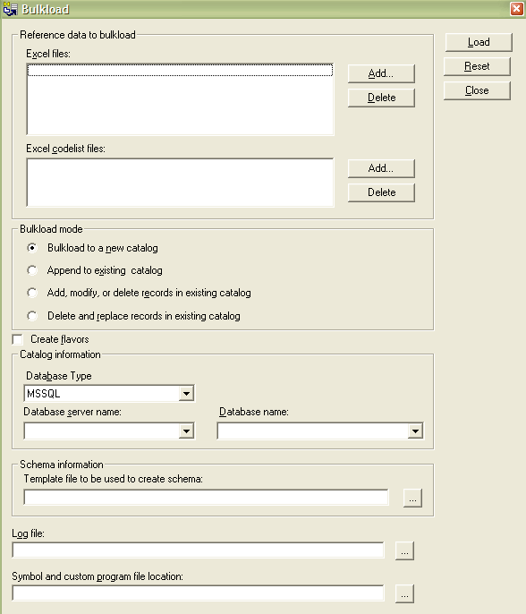
Bulkload Utility
The Bulkload Utility provides the primary mechanism to create/add/modify the catalog database. The data for creating the database is defined using Excel workbooks.
Bulkload Mode:
  Bulkload to a new catalog: is used for creating new catalog database
  Append: Add new data only
  Add/Modify/Delete: is used for update data
  Delete & Replace: is used to replace data in the database with the data currently in the workbooks

Slide 13
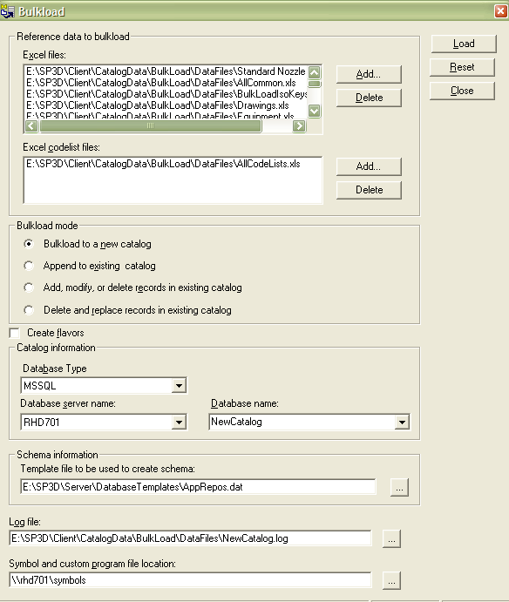
Bulkload Utility
Create New Catalog
- Bulkload to a new catalog

Slide 14
CatalogDB.Dat/CatalogDB.dmp
Step 1
Company Excel sheets
Step 2
Bulk Load Utility
Step 3
SQL Enterpriser Manager
Or Oracle
Catalog &
Catalog Schema
Backup Catalog
Backup Catalog Schema
UserCatalogdb.dat or UserCatalogdb.dmp
Notes:
10
6

Slide 15
Using Excel Workbooks to Configure
Catalog Data
  Common Sheets
  Revision History*
  Legend*
  Index*
  CatalogRoot
  ClassNodeType
  R-ClassNodeDescribes
  R-Hierarchy
  Custom Interfaces
  GUIDs
  * The Bulkload utility does not process these sheets, so you can enter any comments and information on them.

Slide 16
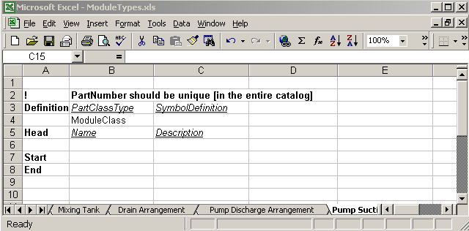
Using Excel Workbooks to Configure
Catalog Data
  Bulkload Excel Format
  The “Head”, “Start” and “End” are always required in the first column. One can have as many empty rows as he/she wants to, anywhere in the sheets. Comments can be put by putting “!” in the first cell of the row in which the comment needs to be put.
  Letter bulkload mode A,M,D

Slide 17
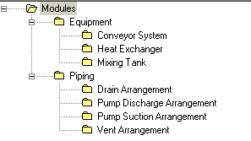
Common Sheets
Organizational Hierarchy Sheets
Hierarchy sheets provide the means to manage which items and where items are displayed in the Catalog Task.
CatalogRoot
ClassNodeType
R-Hierachy (parent-child relations)
R-ClassNodeDescribes
Object Class
© 2006. Intergraph Corporation. All Rights Reserved.
Notes:
10
4

Slide 18
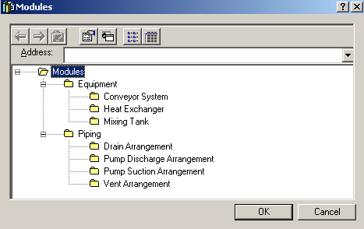
Module Types
Notes:
Page 78

Slide 19
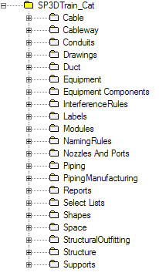
Using Excel Workbooks to Configure
Catalog Data
  Catalog Hierarchy
  CatalogRoot

Slide 20
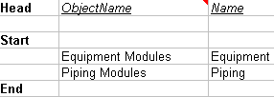
Using Excel Workbooks to Configure
Catalog Data
  ClassNodeType
    allows you to create a classification folders in the Catalog hierarchy.
    Object Name column: folder object name
    Name column: folder name in the GUI.

Slide 21
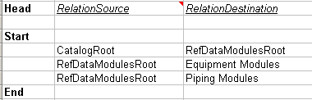

Using Excel Workbooks to Configure
Catalog Data
  R-Hierarchy
    contains the parent-child relationships between folders in the Catalog Hierarchy.
    RelationSource column: specifies the parent object names.
    RelationDestination column: specifies the children object names.

Slide 22
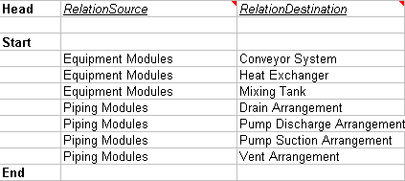
Using Excel Workbooks to Configure
Catalog Data
  R-ClassNodeDescribes
    Defines the parent-child relationships between the classification folders and the part classes.
    RelationSource column: specifies the classification folder.
    RelationDestination column: specifies the object classes associated with the classification folder.

Slide 23
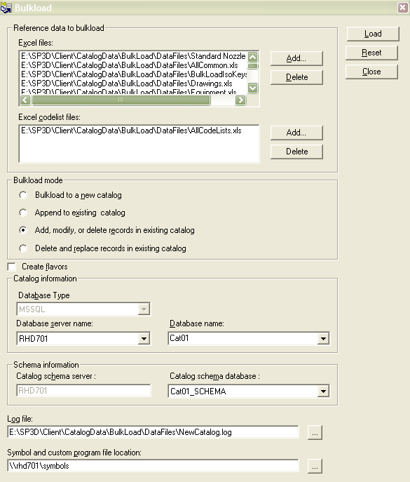
Bulkload Utility
Mode:
Append
Add/Modify/Delete
Create Flavors
Flavors apply to
Solid Edge parts only.
You should close all Excel workbooks
before starting the bulkload. Do not
open Excel during the bulkload.

Slide 24
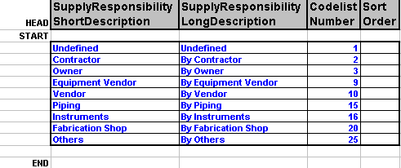
Code List
Codelists – Key or common terms that have been grouped and enumerated.
Key Columns:
  Short/Long Description
  Codelist Number
  Sort Order (Not used in 6.1)
Notes:
Appendix A

Slide 25
Reference Data Management
Step 1
Bulk Load Utility
Step 2
View Generator Utility or Synchronize Model with Catalog Command
Step 3
ProjectManagementTask
Re-generate the reports database command
Catalog &
Catalog Schema
Model
Report &
Report Schema
Bulk load utility will update the views in the catalog database
View Generator Utility will update the views in the model database or
Synchronize model with catalog command will update the views and re-compute all the part occurrences in the model
Re-generate the report database command will re-generate the views in the report.
Notes:
10
6

Slide 26

Common Sheets
Using Excel Workbooks to Configure
Catalog Data
CatalogRoot
ClassNodeType
R-Hierarchy (parent-child relations)
Equipment Assembly Class
A Equipment Assembly Class is a grouping of items that share similar characteristics
© 2006. Intergraph Corporation. All Rights Reserved.
Notes:
10
4

Slide 27
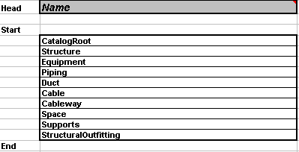
Using Excel Workbooks to Configure
Catalog Data
  Catalog Hierarchy
  CatalogRoot

Slide 28

Using Excel Workbooks to Configure
Catalog Data
  ClassNodeType
    allows you to create a classification folders in the Catalog hierarchy.
    Object Name column: folder object name
    Name column: folder name in the GUI.

Slide 29
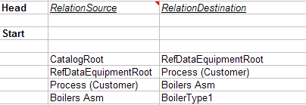
Using Excel Workbooks to Configure
Catalog Data
  R-Hierarchy
    contains the parent-child relationships between folders in the Catalog Hierarchy.
    RelationSource column: specifies the parent object names.
    RelationDestination column: specifies the children object names.

Slide 30
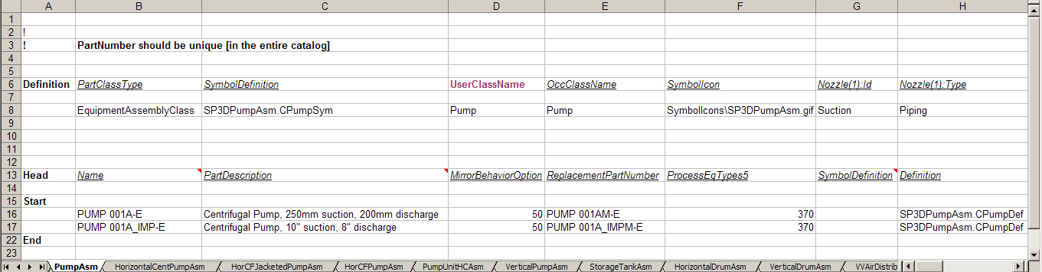
Using Excel Workbooks to Configure
Catalog Data- Part Class Sheet
Equipment Assembly Class is a grouping of smart items that share similar characteristics

Slide 31
Class Definition
  Part Class Type: Type of Class (Example: EquipmentAssemblyClass)
  Symbol Definition: Default Geometric definition for all the parts under this class
  SymbolIcon: Specifies a graphic file for the preview dialog of the part class
  UserClassName: Sets the user name for the part class that appears in the Catalog Browser.
OccClassName: Sets the occurrence name for the part class that appears in the filter dialog box.
  Port ID’s: Defines the port ID
  Port Type: Defines the port Type
  Occurrence Attributes: are properties that you can change for a specific part in the model.

Slide 32
Parts
Part section consists of the following:
Common Properties
Custom Assembly Definition
Custom Properties
Port Data

Slide 33




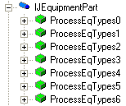
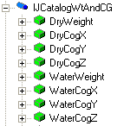
Equipment Data Model
Common Properties
Custom Properties
The Custom Interfaces sheet defines the customized user interfaces and attributes (properties) for the part classes.
Notes:
10
6

Slide 34
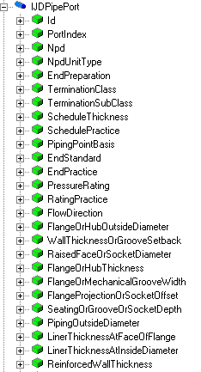
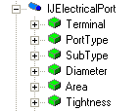
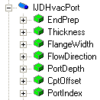
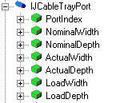
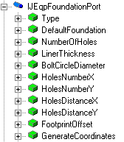
Equipment Data Model
Port Properties
Notes:
10
6

Slide 35
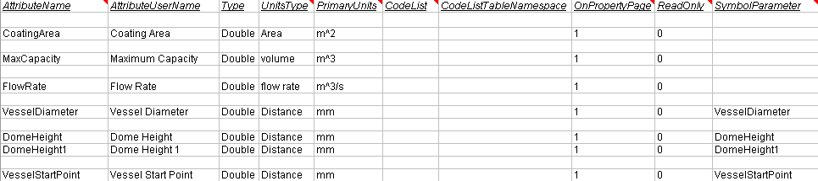
Custom Interfaces Sheet
The Custom Interfaces sheet defines the customized user interfaces and attributes (properties) for the part classes in the workbook.
An interface is a collection of attributes.
Provides a mechanism to map the attributes of the part class to the symbol inputs.
When you bulk load the workbook, the software looks at each user attribute on the class sheets and uses the Custom Interfaces sheet to decode the information.

Slide 36

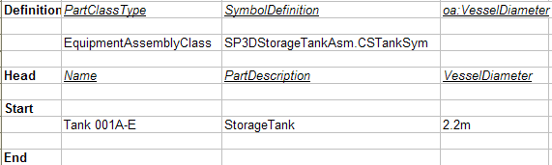
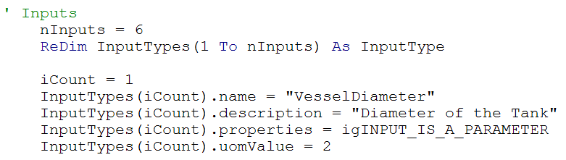
Using Excel Workbooks to Configure
Catalog Data

Slide 37
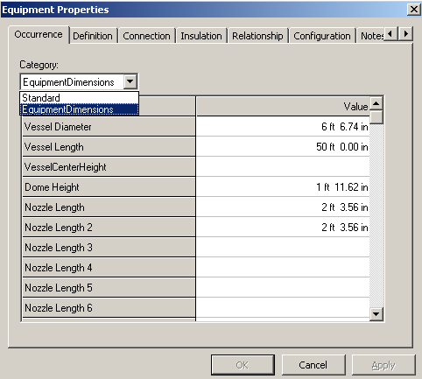
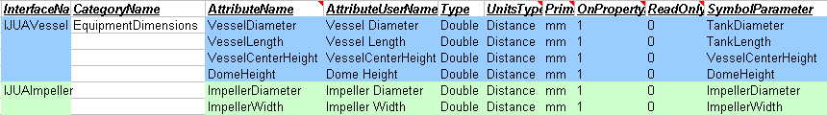
Custom Interfaces Sheet
Category Name
Category Name (CodeList)
Attribute Name
Attribute User Name
Attribute User Name

Slide 38

Custom Interfaces Sheet
  An attribute with the same name can exist on more than one interface. On a part class
  sheet, you can scope the user attributes based on their interfaces and symbol
  parameters. The scoping syntax is
  Interface::UserAttribute<Symbol Parameter>.

Slide 39
Custom Interfaces Sheet
  When an object uses a single attribute from an interface, the object also inherits all the attributes for that interface regardless of whether the object uses the other attributes.

Slide 40
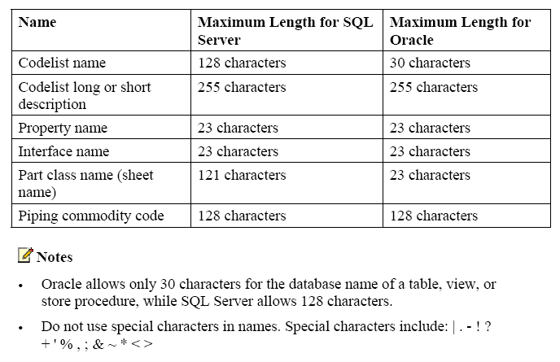
Using Excel Workbooks to Configure
Catalog Data
  Name Limitations
Notes:
Appendix C

